Slide 1

COMP 4300
Intro to Game Programming
Final Project Presentation
Game Name Here
Member Names Here
Replace With Graphics From Your Game

Slide 2
Notes (Remove this Slide)
Use this template for your presentation
Change colors / theme to match game
Project video should be 20-25 mins
If it’s too long or too short, please re-record so it’s in the correct time limit
Ideally each person speaks for what they implemented, but not 100% required

Slide 3
Notes (Remove this Slide)
Each required feature has a text slide where you list which things got implemented and which didn’t
Also list what you did for that feature (weapon types, item types, etc)
Following slide(s) should be video clip(s) showcasing those features working

Slide 4
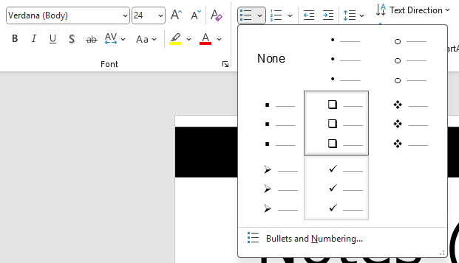
Notes (Remove this Slide)
For each slide listing required features, replace completed features with a check mark from the bullet point list above
For example
  Feature 1
  Feature 2
  Feature 3

Slide 5
Notes (Remove this Slide)
For each feature that did not get implemented fully, leave the check box blank and give a quick explanation of what you tried and why it didn’t work
If the reason was that you ran out of time, just state that, it’s fine

Slide 6
Notes (Remove this Slide)
You shouldn’t spend much time on the text slide portion of each feature, that is just intended as a checklist to show me
Show the checklist, briefly explain if necessary, then go to the next slide video and explain while the video is playing
This will save time overall

Slide 7
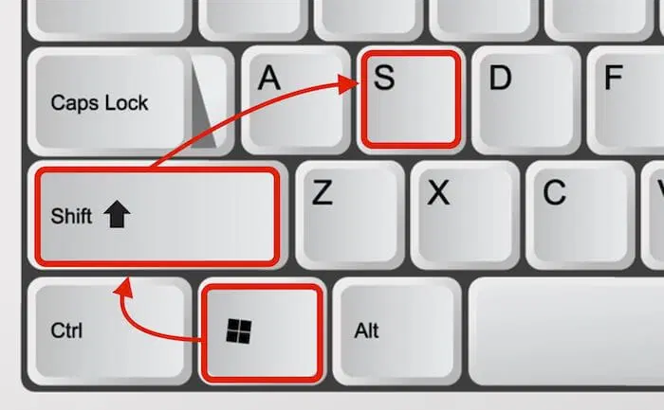
Notes (Remove This)
Feel free to include screenshots on any of the text slides if you feel it helps explain things easier. Sometimes a still image helps explain better than a video
Screenshots should only
include relevant content
not the entire screen

Slide 8
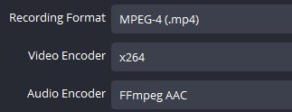
Notes (Remove this Slide)
I recommend using OBS to record clips
  https://obsproject.com/
Recording Settings (For PowerPoint)
  Source = Game Window Only (not full screen)
  720p resolution minimum
  Video Encoder = x264
  Filetype = mp4

Slide 9
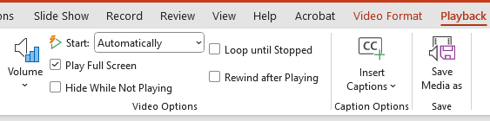
Notes (Remove this Slide)
Drag the video clip into the powerpoint slide and change the Playback settings so that it auto plays full-screen. This will start the video as soon as you change slides

Slide 10
Notes (Remove This)
Once the presentation contains all the correct content, record your group giving the full presentation with OBS
Edit out any major mistakes
Upload to YouTube and link on GitHub
I will be grading the presentation mostly on content, not video editing skills
I don’t want PowerPoint file, just the video link

Slide 11
Notes (Remove This)
If a feature does not appear in the presentation, I probably won’t know it’s completed and can’t give marks for it
I simply don’t have time to play each game in complete detail to find features
Please make sure each feature is contained in a video clip at least once

Slide 12
Notes (Remove This)
Remove this slide and all previous note slides from your presentation
Your presentation should start with the title screen, followed by the next slide
You don’t need to finish the project code to start working on the presentation
Edit sections as you finish features

Slide 13
Game Overview
Game Name
Type / style of game
  Platformer, Top-Down, RPG, etc
Theme of the game
  Basic story / theme
Inspiration
  Did you get the idea from somewhere?
This slide can be replaced with a video if you feel it is nicer than just text

Slide 14
Group Members
Group Member 1 Name
  Did feature 1, feature 2, etc
Group Member 2 Name
  Did feature 3, feature 4, etc
Group Member 3 Name
  Did feature 420, feature 67, etc
Group Member 4 Name
  Did feature 888, feature 666, etc

Slide 15
Game Assets
Types of assets used
Asset sources / links
Examples of a couple of animations you made from textures found
Explain any assets you made from scratch
It is ok to use AI to create assets

Slide 16
Sample Asset
Screenshots

Slide 17
Scenes
Main Menu Scene Checklist only
Overworld Map Scene No video
Gameplay Scene
Level Editor Scene Explain if you
Inventory Scene did something
Game Over Scene differently
Other Extra Scenes

Slide 18
Main Menu and Options / Audio
Explain main menu and options here
Required Features
  Options Menu
  Music Volume
  Sound Effect Volume
  Change Difficulty
  Rebinding Keys

Slide 19
Video Goes Here
(Main Menu and Options
Demo Audio Music + Effects
As Volume Changed)

Slide 20
Level Editor
Select existing level to edit
Place / change animations
Save level
Load level
Edit npc ai parameters
Edit moving tile parameters

Slide 21
Video Goes Here
(Level Editor Feature Demo
This should be a longer clip)

Slide 22
User Interface + HUD
Player Health
Weapons and Ammo
Game Progression
Status Effects / Timers
Other UI Elements
  UI Element 1
  UI Element 2

Slide 23
Video Goes Here
(UI + HUD Explained)

Slide 24
Collision + Movement + Gravity
Collision Types
  Collision 1
  Collision 2
Gravity Effect
Movement Abilities
  Ability 1
  Ability 2

Slide 25
Video Goes Here
(Movement Abilities + Collision
Demo the gravity effect)

Slide 26
Bullets / Weapons
Weapon Types
  Weapon 1
  Weapon 2
  Weapon 3
Weapon Swapping
Consumable ammo

Slide 27
Video Goes Here
(Movement Abilities + Collision)

Slide 28

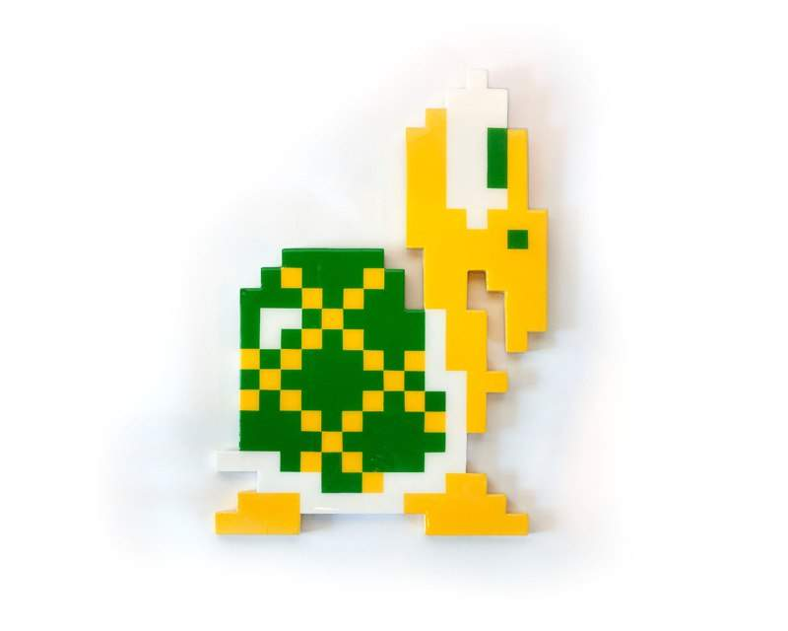

NPCs
NPC Types
  NPC 1
  NPC 2
  NPC 3
NPC AI Types
NPC Weapon Types

Slide 29
Video Goes Here
(NPCs, AI, Abilities, Weapons)

Slide 30
Hit Points / Damage
Players / Enemies Deal / Take Damage
Invincibility Frames
Hit Points can be visibly displayed
Any other details

Slide 31
Video Goes Here
(Hit Points and Damage)

Slide 32
Objects / Inventory
Game Items
  Item 1
  Item 2
  Item 3
In-Game Inventory
Items usable via in-game menu

Slide 33
Video Goes Here
(Items and Inventory)

Slide 34
Ray Casting / Visibility
Ray Casting for Visibility
  Visibility Example
Ray Casting for Lighting
  Lighting Example

Slide 35
Video Goes Here
(Show Visibility then Lighting
Can be 2 separate clips)

Slide 36
Camera / World Views
Camera Types Implemented
  Camera Type 1
  Camera Type 2

Slide 37
Video Goes Here
(Camera / View Types)

Slide 38
Status Effects / Shaders
Status Effects
  Effect 1
  Effect 2
  Effect 3
Shaders Used
  Shader 1
  Shader 2
  Shader 3

Slide 39
Video Goes Here
(Status Effects and Shaders
Can be multiple clips)

Slide 40
Parallax
Parallax Implemented
  Explain type
  Some implementation details
  (no code, just high level how you did it)
  Show all examples of parallax in video

Slide 41
Video Goes Here
(Parallax)

Slide 42
Pathfinding or Steering
Non-trivial pathfinding
  Example
Steering Behavior
  Example
(delete the one you didn’t do)

Slide 43
Video Goes Here
(Pathfinding or Steering)

Slide 44
Extra Features
Extra feature 1
  Explain
  Feature Here
Extra feature 2 (if applicable)
  Explain here

Slide 45
Video Goes Here
(Fully show extra features)

Slide 46
Game Progression
Overworld map
Progress save / load
Level unlocking
(this can be combined with the next section game levels and playthrough if you wish)

Slide 47
Video Goes Here
(Game Progression Only
Not full level gameplay)

Slide 48
Game Levels / Playthrough
Show level design / examples
Demo a full level completion and how progress was unlocked
  Show moving tiles / platforms here
Show boss fight / explain mechanics
Show game over screen

Slide 49
Video Goes Here
(Game Level Design)

Slide 50
Video Goes Here
(Full Level Completion
Show Moving Tiles / Platforms)

Slide 51
Video Goes Here
(Boss Fight + Details
Game Over Screen)

Slide 52
Anything Else?
Put it here!

